Slide 1
Hadoop Webcrawlers
Huy Pham, Veronica McGhee, Jesse Stewart, Tara Walton

Slide 2
Introduction
A little about Hadoop… The Apache Hadoop software library provides a scalable framework for distributing and processing large data sets.

Slide 3

What is Hadoop?
Hadoop Common
Supports all other Hadoop modules
HDFS (Hadoop Distributed File System)
Distributed file system that provides high-throughput access to application data
Hadoop YARN (Yet Another Resource Negotiator)
Framework for job scheduling and cluster resource management
Hadoop MapReduce
YARN-based system for parallel processing of large data sets
Notes:
Hadoop first came around in 2003 when a paper on the Google File System was first published.
The term Hadoop has come to mean more than just the modules that make up Hadoop, but includes the ecosystem that can be installed in conjunction with Hadoop.

Slide 4
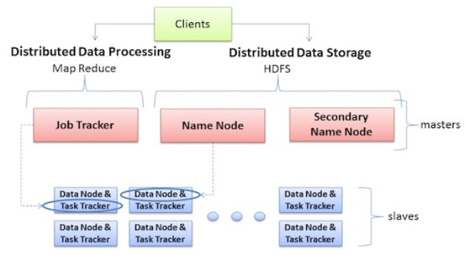

Slide 5





Who uses Hadoop? (And for what…)
Now it is used by companies such as : Amazon A9.com (Analytics and search indices) Cornell (University Web Lab - generating web graphs on 100 nodes) eBay (Search optimization) Facebook (Streaming, analytics) Greece.com (Analyzing data for images,
log analysis, and data mining) LinkedIn (People you may know, dashboard, skills)

Slide 6

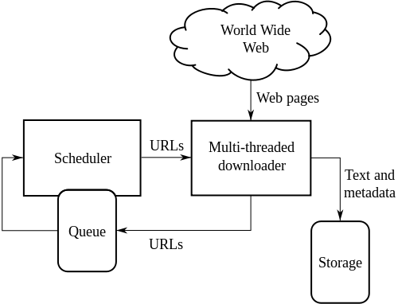
Our brand of Hadoop….
Nutch is specifically for webcrawling. It is pluggable and modular and can be run on top of other Hadoop tools including Apache Tika and Apache Gora.
While it can run on a single machine, it gains a lot of its strength from running in a Hadoop Cluster.
Notes:
Web crawler AKA Spider, Ant, Automatic Indexer

Slide 7
Steps
Generator
Creates a batch and selects URLs to fetch from the webtable
Fetcher
Fetches all URLs marked by the generator within a batch ID
Parser
Optionally done during fetch using fetcher.parse
Database Updater
Updates all rows with inlinks (backlinks), fetchtime and the correct score
Notes:
A crawler starts with a set of URLs called seeds and the crawler visits each of these sites and identifies all the hyperlinks, adding them to the to-do list. Pages are then visited recursively according to policy and added to a repository, something similar to a database with less functionality, called a webtable.

Slide 8
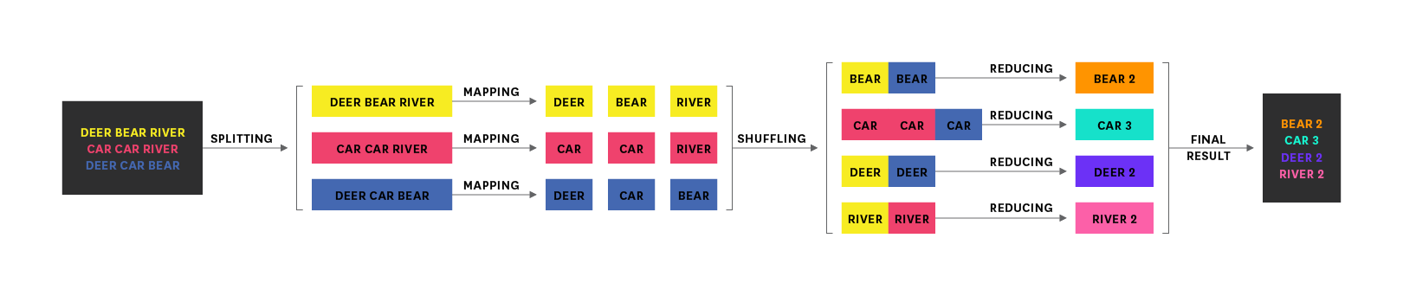
MapReduce process
operates exclusively on <key, value> pairs.
(input) <k1, v1> → map → <k2, v2> → combine → <k2, v2> → reduce → <k3, v3> (output)

Slide 9
Generate
Mapper
Partitioning
Reducer

Slide 10
Mapper
Creates a new batch. Selects URLs to fetch from the web table.
Generates a fetch list from the CrawlDB.
Mapper: reads every URL from the web table (a given set of webpages to start)
Optionally it normalizes the URL to avoid redundancy
Calculate scoring for this URL based on policy
Outputs every URL that needs to be fetched, together with its score.
Notes:
This is disabled for fast generating of URLs

Slide 11
Partition
All URLs are partitioned by domain, host or IP.
URLs in the same partition are sent to the same thread for reduction.
Within each partition all URLs are sorted by score (best first).
Optionally it normalizes the URL to avoid redundancy
Notes:
This is disabled for fast generating of URLs
When partitioning by IP: this can be heavy on DNS resolving

Slide 12
Reduce
Reads every URL from the partition and keeps selecting URLs until the total number of URLs has reached a set limit
Add URLs until the topN number of reducers is reached.
Gives us topN URLs for all reducers together
The reducer keeps track of the number of URLs included for a certain domain using a map until the number of URLs for that domain exceeds the max
If the map becomes too large, it is always possible to increase the number of reducers.
For each selected URL, write a generate mark (batch ID)
Output the row to the web table

Slide 13
Fetching process
MAPPER
PARTITION
Reduce

Slide 14
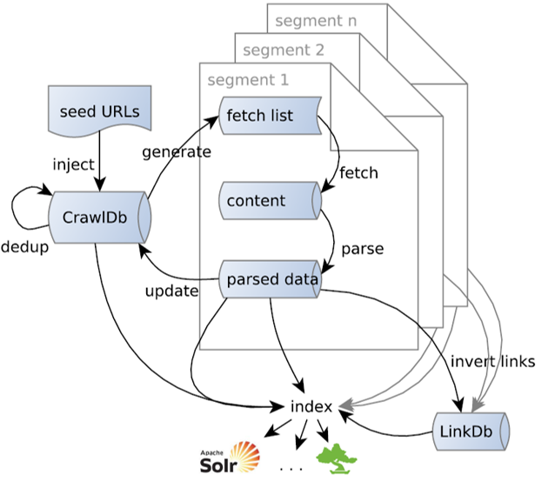
Mapper
Assigns data to dataNodes and ensures that the data was marked by generator and included in the webtable[2]

Slide 15
Partition
HDFS Cassandra partitions across the cluster automatically using hashing and sorting [4]
The fetcher mapper uses its own partitioner by host since fetcher reducer can work with queues by host, domain and IP[2]

Slide 16
Reduce
Stores URLs in searchable queues
Fetch each URL
Mark webtable if succeeded or failed
crawl_fetch: status from fetch (e.g., success, failed, robots denied)
content: fetched binary content and meta data (HTTP header) This is sample pseudo code before it goes into the parsing process [3].
If parsing configured: parse contents [2]

Slide 17
Step-by-Step FETCHING
//A fetch list is created:
bin/nutch generate crawl/crawldb crawl/segments
//the list is stored in a segment directory and it gets assigned it to s1
s1=`ls -d crawl/segments/2* | tail -1`
echo $s1
//Fetcher is run on this segment and contents are optionally parsed
bin/nutch fetch $s1
bin/nutch parse $s1
//Database is updated
bin/nutch updatedb crawl/crawldb $s1

Slide 18
Step-by-Step FETCHING (cont’d)
//Next we create a new segment with updates as well as newly discovered entries containing the top 1,000 pages
bin/nutch generate crawl/crawldb crawl/segments -topN 1000
s2=`ls -d crawl/segments/2* | tail -1`
echo $s2
bin/nutch fetch $s2
bin/nutch parse $s2
bin/nutch updatedb crawl/crawldb $s2

Slide 19
Step-by-Step FETCHING (cont’d)
//Repeating the process
bin/nutch generate crawl/crawldb crawl/segments -topN 1000
s3=`ls -d crawl/segments/2* | tail -1`
echo $s3
bin/nutch fetch $s3
bin/nutch parse $s3
bin/nutch updatedb crawl/crawldb $s3
//Fetching results in 1,000's of useful pages needing to be indexed[Mcgibnney]

Slide 20
Parsing
mapper

Slide 21
Back to the Mapper…
Reads every webpage from the webtable
Check if the fetch mark matches
If this webpage has been parsed before (even in a another batch) then it skips that entry.
Run parsers on the row
Output the row to the webtable

Slide 22
Database Update
Mapper
Partition
Reduce
Notes:
Updates all rows with inlinks (backlinks), fetchtime and the correct score.

Slide 23
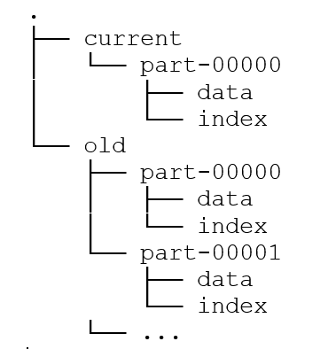
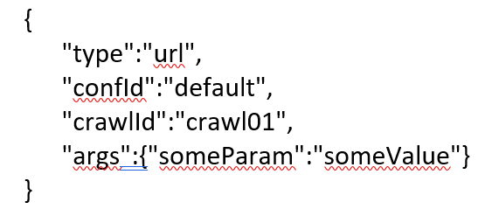
Crawldb structure
Nutch 1.X: Directory structure
Nutch 2.X: webtable
All information about a URL/document in a single row: status, metadata, binary content, extracted plain-text, inlink anchor….

Slide 24
Mapper
Master looks at each webpage in the webtable, sends the parsed rows to its slaves.
The slaves receive these Parsed URLs, calculate a score for them based on the number of links away from those pages (and the text near those links), and sends the URLs and scores back to the Master

Slide 25
Partition
Partition by {url}.
Sort by {url,score}.
Group by {url}.
This ensures the inlinks are sorted by score in the reducer.

Slide 26
Reduce
The master calculates and updates the webpage scores based on the number of links to those pages from other ones.
The master stores this information to the database.

Slide 27
References:
[1] Kofler, R. (2015, December 02). Scraping the Web with Nutch for Elasticsearch . Retrieved from https://qbox.io/blog/scraping-the-web-with-nutch-for-elasticsearch
[2] Mcgibbney, L. J. (2016, November 21). NutchTutorial. Retrieved May 07, 2017, from https://wiki.apache.org/nutch/NutchTutorial
[3] Nagel, S. (n.d.). Web Crawling with Apache Nutch. Retrieved November 18, 2014, from http://events.linuxfoundation.org/sites/events/files/slides/aceu2014-snagel-web-crawling-nutch.pdf
[4] S. Khalifa, Y. Elshater, K. Sundaravarathan, A. Bhat, P. Martin, F. Imam, D. Rope, M. Mcroberts, and C. Statchuk, “The Six Pillars for Building Big Data Analytics Ecosystems,” ACM Computing Surveys, vol. 49, no. 2, pp. 1–36, Feb. 2016.

